Slide 1


HACKATHON 2024
LNRS HACKATHON 2024

Slide 2

ABOUT ME
Name: Nikhil Jain
Email Id: jainnikhil1402m@gmail.com
Contact No: 7021707461
GitHub Account: NJ-7021
Topic: Fake news detection
College: SVKM NMIMS
Student Id: 70012100164
Repo Link:NJ-7021/LNRSHACKATHON_NIKHILJAIN (github.com)

Slide 3
Contents
Introduction
Motivation
Libraries used
Dataset
Code (Input)
Output
Video
Conclusion

Slide 4
What is Fake News?
Definition: Fake news is false or misleading information that looks like real news.
Importance of Detection: In the digital age, fake news spreads rapidly through social media and other platforms, leading to significant consequences such as:
Misinformation in Elections: Manipulating public opinion.
Public Health Risks: Spreading false information during crises (e.g., COVID-19).
Economic Impact: Affecting stock markets and consumer trust.
LNRS HACKATHON 2024

Slide 5
Why is Fake News Detection Important?
Societal Impact
Political Impact
Economic Impact
Real World Consequences
The Need for Detection
LNRS HACKATHON 2024

Slide 6
Libraries Used
Pandas:
Purpose: Data manipulation and analysis.
Usage: Loading the dataset (news.csv), handling data frames, and separating features and labels.
Pickle:
Purpose: Serializing and deserializing Python objects.
Usage: Saving the trained model to a file so it can be loaded later without retraining.
LNRS HACKATHON 2024

Slide 7
Libraries Used
Scikit-learn:
Purpose: Machine learning library for Python.
Usage:
Feature Extraction: Using TfidfVectorizer to convert text data into numerical format.
Modelling: Implementing the PassiveAggressiveClassifier for classification tasks.
Model Evaluation: Functions like train_test_split, accuracy score, and confusion_matrix to evaluate model performance.
Flask:
Purpose: A lightweight web framework for Python.
Usage:
Routing: Define URL routes to map to specific functions
Running the App: Use app.run() to start the Flask server.
LNRS HACKATHON 2024

Slide 8
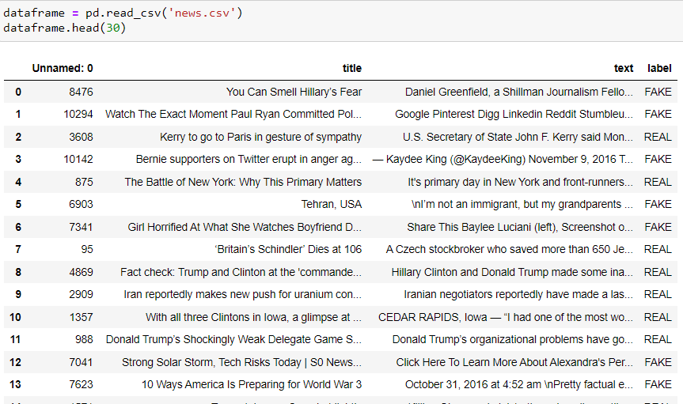
Dataset Used
LNRS HACKATHON 2024

Slide 9
Classifiers Used
PassiveAggressiveClassifier:
Purpose: A machine learning algorithm used for large-scale learning and online learning, updating the model as new data arrives.
Usage:
Online Learning: Continuously updates the model when a misclassification occurs.
Fake News Detection: Helps classify news articles as real or fake based on textual features.
LNRS HACKATHON 2024

Slide 10
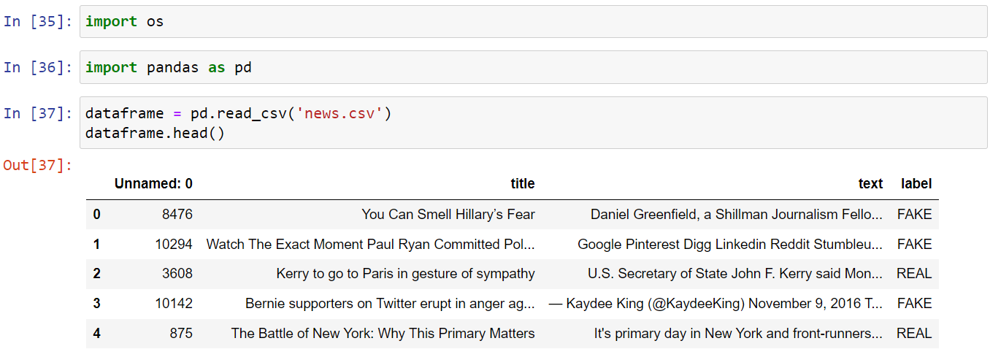
Code(Input)
LNRS HACKATHON 2024

Slide 11
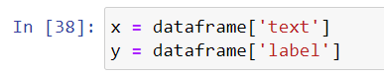
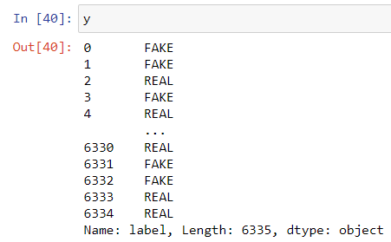
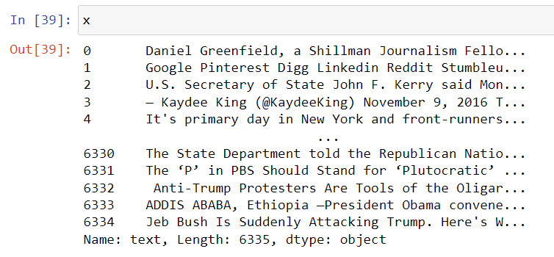
Code(Input)
LNRS HACKATHON 2024

Slide 12
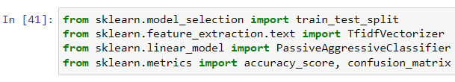
Code(Input)
LNRS HACKATHON 2024

Slide 13
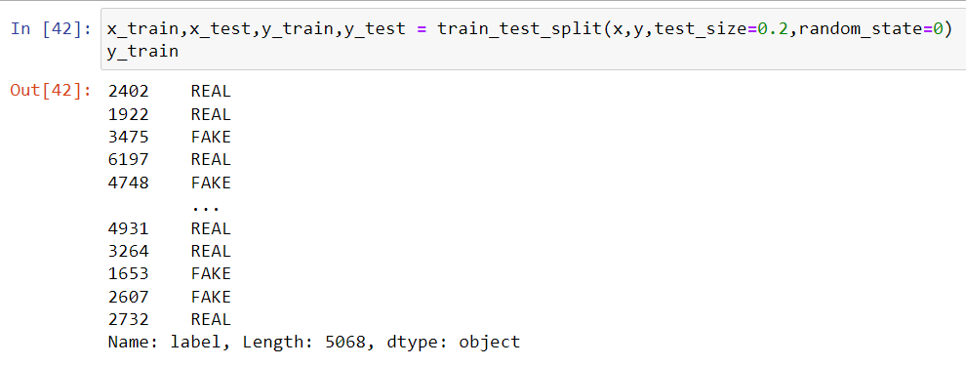
Code(Input)
LNRS HACKATHON 2024

Slide 14
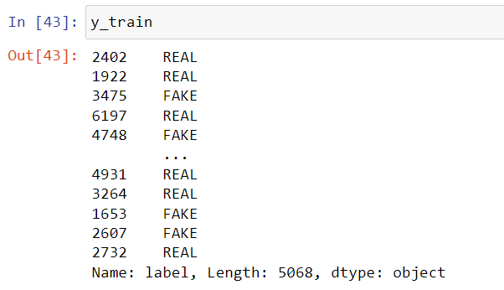
Code(Input)
LNRS HACKATHON 2024

Slide 15
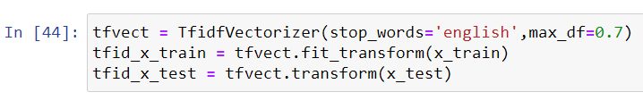
Code(Input)
LNRS HACKATHON 2024

Slide 16
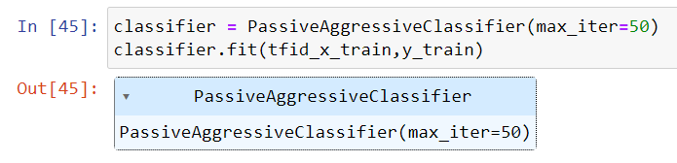
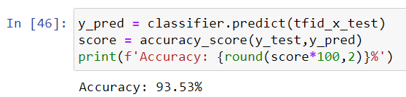
Code(Input)
Classifier Used
Accuracy
LNRS HACKATHON 2024

Slide 17
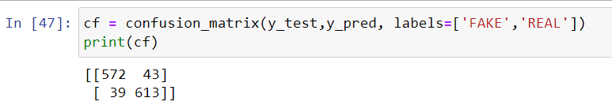
Code(Input)
Confusion Matrix
LNRS HACKATHON 2024

Slide 18
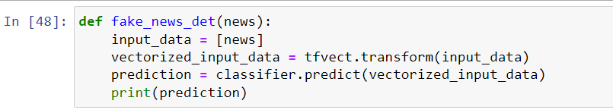
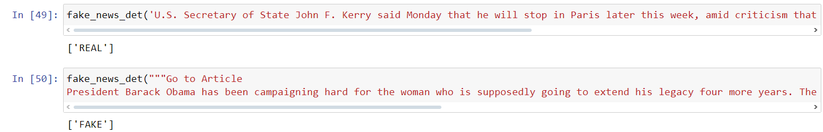
Output
LNRS HACKATHON 2024

Slide 19
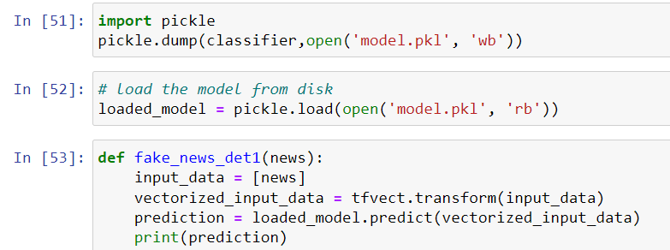
Code(Input)
Using Pickle
LNRS HACKATHON 2024

Slide 20
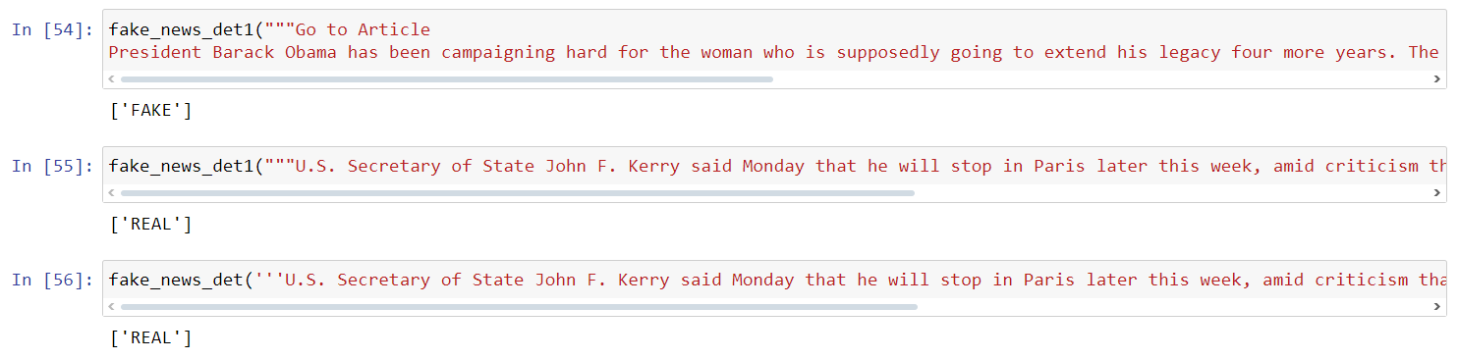
Output
LNRS HACKATHON 2024

Slide 21
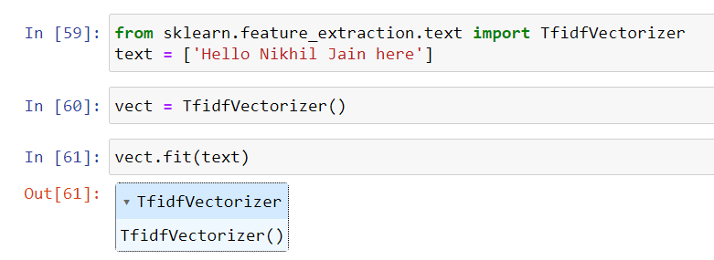
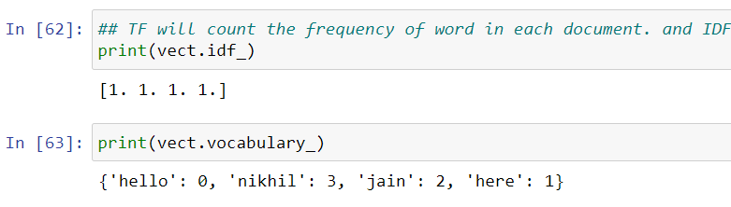
Code
LNRS HACKATHON 2024

Slide 22
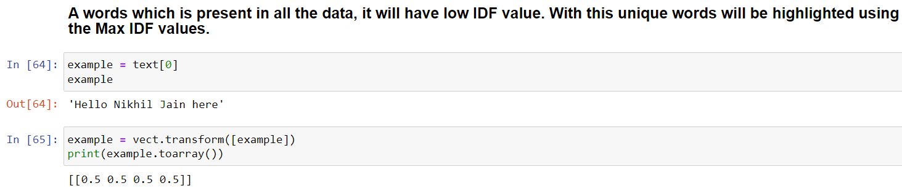
Code
LNRS HACKATHON 2024

Slide 23
Web app
Used
HTML
CSS
Flask
LNRS HACKATHON 2024

Slide 24
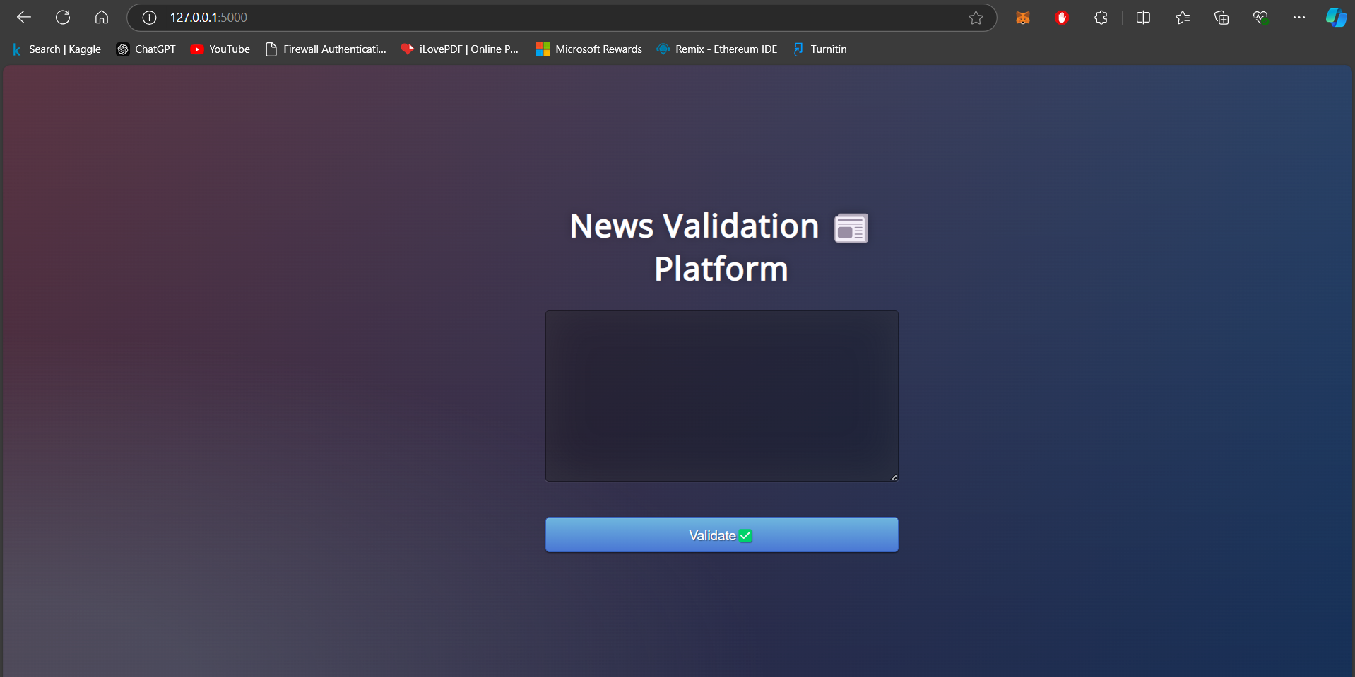
Fake News
LNRS HACKATHON 2024

Slide 25
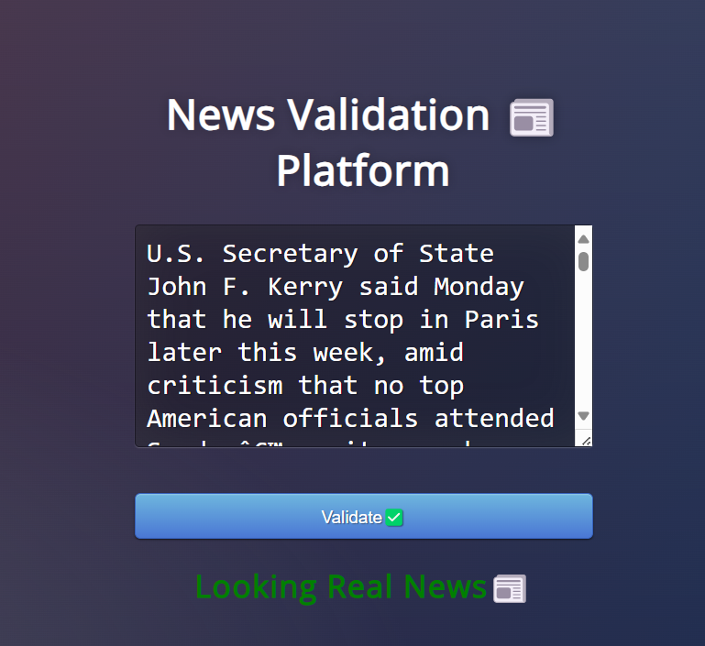
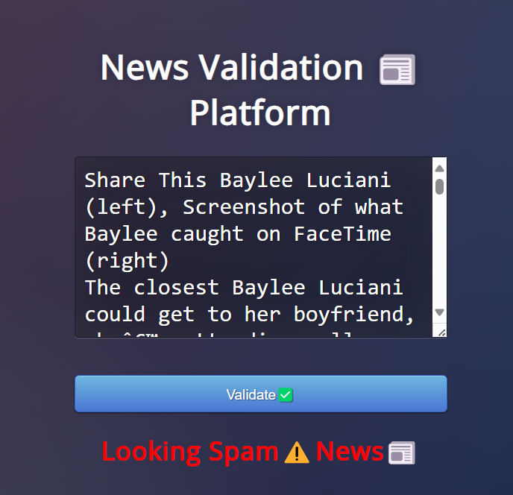
Working
LNRS HACKATHON 2024

Slide 26
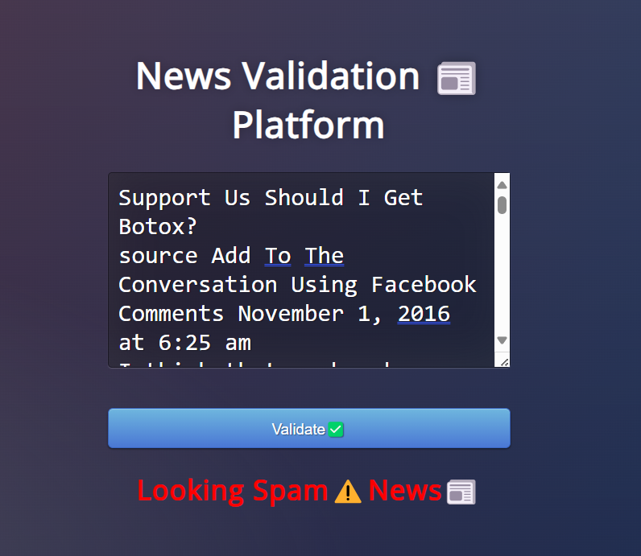
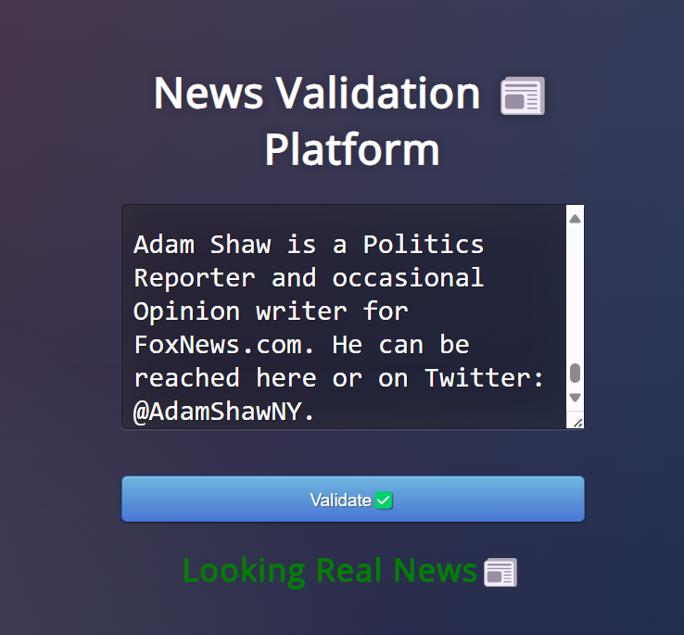
Working
LNRS HACKATHON 2024

Slide 27
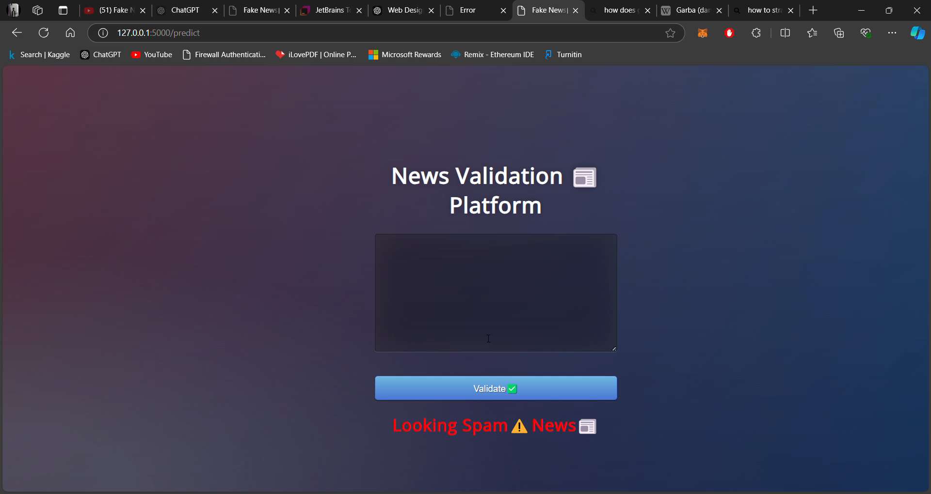

Slide 28
Conclusion
Detecting fake news is crucial in combating misinformation. Machine learning models help automate this process, but challenges like biased data and sophisticated fake news (e.g., deepfakes) persist. Future improvements could include better accuracy, advanced NLP techniques, and multimedia verification for detecting fake images and videos.
LNRS HACKATHON 2024

Slide 29
Future Scope
Deep Learning Models:
Implementation of deep learning models like BERT and GPT can greatly improve the understanding of text, context, and semantics, leading to better detection of subtle fake news.
Detecting Fake Multimedia:
Future systems can be enhanced to identify not only fake news articles but also fake images and videos (deepfakes), using image recognition and video analysis technologies. This would broaden the scope of automated fake content detection.
LNRS HACKATHON 2024

